Slide 1
ANARCHIsM

Slide 2
Past Questions (15 mark)
Explain the link between anarchism and individualism (x2)
Explain the link between anarchism and collectivism. (reconcile collectivism & freedom?)
On what grounds have anarchists rejected constitutionalism and consent? (so oppose the state)
On what grounds do anarchists believe in the possibility of a stateless society?
Why do anarchists view the state as inherently evil and oppressive? (x2)
How and why have anarchists been associated with socialism? (is anarchism socialism without the state?)
How does the anarchist view of the state differ from the Marxist view?
How and why has anarchism been linked to communism?

Slide 3
Past Questions (45 Mark)
To what extent is anarchism a single doctrine?
‘Anarchism is closer to liberalism than it is to socialism.’ Discuss.
‘The notion of a stateless society is merely an anarchist fantasy.’ Discuss.
To what extent do anarchists agree about the nature of the future anarchist society?
‘Anarchists demand the impossible.’ Discuss. (Is it utopian)

Slide 4
Objectives
1. To understand the origins of Anarchism
To identify its core principles
To recognise its strands and links to socialism/liberalism
To place key thinkers within those strands.

Slide 5
Origins
Complex
Ancient Greek: “without rule”
Principles laid down by William Godwin, Essay Concerning Political Justice (1793)
Used in French revolution
BUT Proudhon (1870) first used as a systematic ideology.
Growth of powerful nation states in 19th century

Slide 6
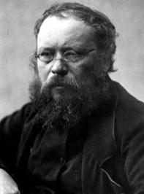
Proudhon
Voted against the French Constitution “because it was a constitution” (1848)
“Democracy is nothing but the Tyranny of Majorities”
To be governed is to be watched over, inspected, spied on, directed, legislated at, regulated, docketed, indoctrinated, preached at, controlled, assessed, weighed, censored, ordered about, by men who have neither the right, nor the knowledge, nor the virtue.

Slide 7
Syndicalism
Popular in France, Spain & Italy in early 20th century
CGT union (France) dominated by anarchists
Also emerged in Latin America
Influenced the Mexican revolution, led by Emiliano Zapata
Weakened by spread of authoritarian regimes

Slide 8
Core themes
Anti-Statism: this is the DEFINING theme! Seek a stateless society.
Optimistic: (utopian?) humans are moral creatures, drawn to absolute freedom & autonomy (private judgement). (But pessimistic about corruption.)
Rejects state power
Seeks political equality.
Emma Goldman (US anarchist) government is “the club, the gun, the handcuff, or the prison.”
(Which 2 ideologies does anarchism overlap and why?)

Slide 9
Natural order
William Godwin: opposed ‘Social Contract’ (Hobbes & Locke) – humans rational and capable of living harmoniously with the law of the State.
Natural ‘goodness’
Volunturism
But Proudhon, Bakunin, Kropotkin etc more nuanced…..human plasticity.
Eg: Social institutions nurture respect & cooperation…so collectivism/common ownership good.
(Why are anarchists against the Church?)

Slide 10
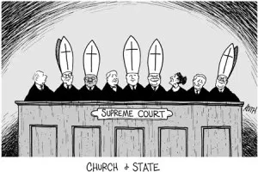
Anti-clericalism
The Church and State often intertwined, especially in Catholic countries (Spain, France, Italy, S. America)
The church provides a moral authority which anarchists reject.

Slide 11
Economic Freedom
Bakunin: “political power & wealth are inseparable”
The ruling class exploits the masses (but, unlike Marx, the ruling class includes all who enjoy privilege and power….priests, the police, state officials, etc)
Like socialists, disapprove of property & inequality
(Why are some anarchists in favour of collectivism and others individualism?)

Slide 12
Collectivism vs individualism
Collectivist anarchists (aka social anarchists) support co-operation and common ownership
Individualists support the free market.

Slide 13
Collectivists
Kropotkin & Proudhon: mutual aid (mutualism): bargaining goods and services without profit.
Bakunin: “Social solidarity is the first human law”
Proudhon distinction between ‘property’ and ‘possessions’ (Property is theft)
Anarchists argue that Marx’s vanguard state would be corrupt and the state must be abolished.

Slide 14
Collectivists (cont’d)
Anarcho-syndicalism: emerged through the trade unions (esp France): class war.
Sorel: revolution through a general strike.
Anarcho-communism: human capacity for co-operation – shared communal existence. Kropotkin: Darwinian evolution leads to social solidarity for success.
Communes allow collective endeavour (solidarity); direct democracy & human interaction (‘communism’).

Slide 15
Individualists
Godwin: individual sovereign (extreme classical liberalism).
No need even for a police force or constitutions.
Egoism: Stirner – individual at the centre of the moral universe.
Libertarianism: Thoreau “That government is best which governs not at all” (misquote Jefferson).
Tucker: ‘labour-for-labour’ exchange. Labour exchanged for a promise of work in kind.

Slide 16
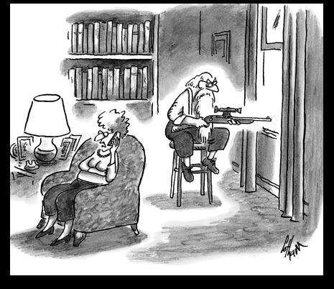
Individualists (cont’d)
Anarcho-capitalists: Nozick, Ayn Rand, etc - free market, limited government (protecting rights).
Rothbard: private police and courts.

Slide 17
Achieved by…
Revolution: Bakunin, Zapata, etc. Often associated with terrorism (eg the Angry Brigade)
Direct Action: Sorel – general strike. Anti-globalisation: Occupy/Noam Chomsky
Pacifism: Tolstoy, Ghandi, etc. Tolstoy: return to simple peasant existence; Ghandi satyagaraha, non-violent non-cooperation.

Slide 18
THE END

